Slide 1
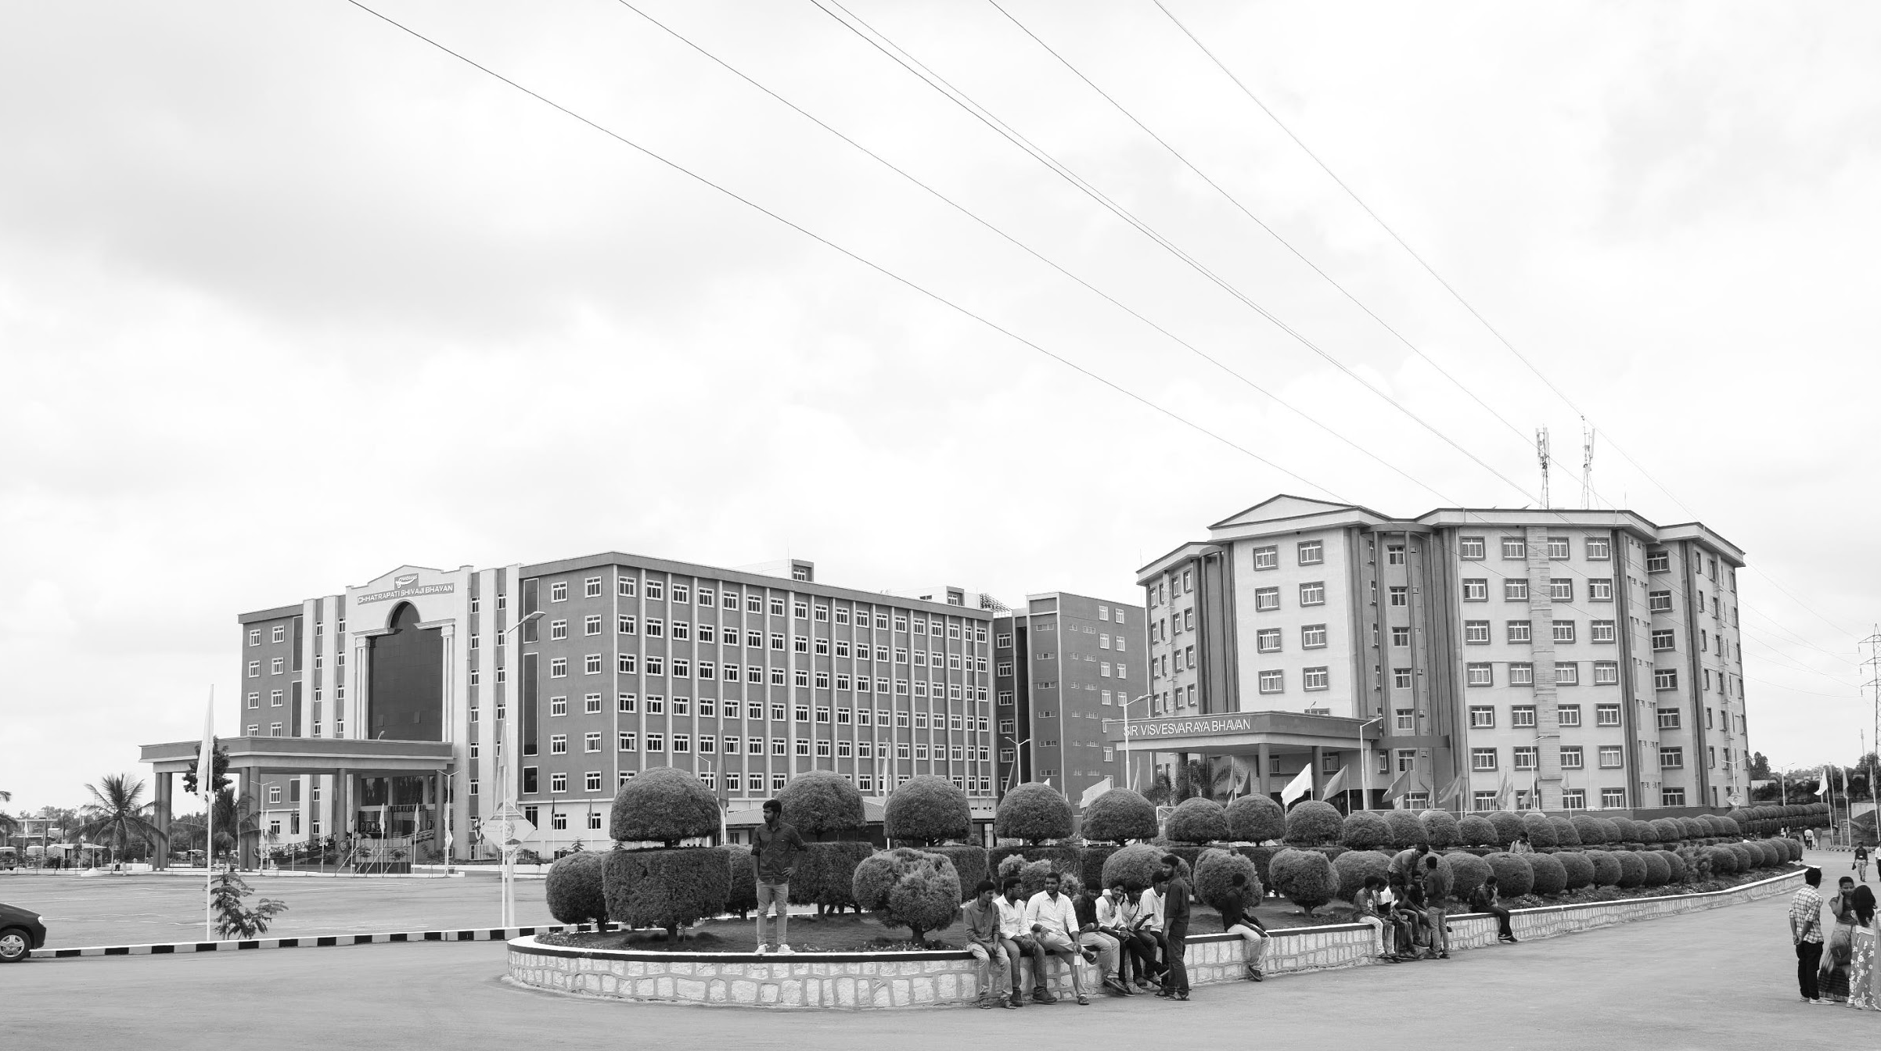

Implementation of vehicle toll collection using GNSS Technologies
Mid-Review 1/2/3
Major Project
Project ID: C17
AY 2021-25
GITAM (Deemed-to-be) University
Project Team:
KHATEEB GOUSIYA
(BU21EECE0100467)
MAVILLA AKASH
(BU21EECE0100206)
SANA SOWMYA
(BU21EECE0100398)
Department of Electrical Electronics and Communication Engineering
Project Mentor:
Dr.Nagarjuna Telagam
Project In-charge:
Pankaj Kandhway
www.gitam.edu

Slide 2
Objective and Goals
Objective
Brief Description
To develop a GNSS-based vehicle toll collection system using MATLAB.
The goal is to track vehicles in real time, calculate toll fees automatically, and make the payment process easy.
This system aims to improve toll collection, reduce traffic, and support smarter transportation.
Goals
Main Goals
1.Implement map-matching for toll calculation using GNSS data.
2.Integrate GNSS Lanes and On board Units(OBU) with the Toll Charger system.

Slide 3
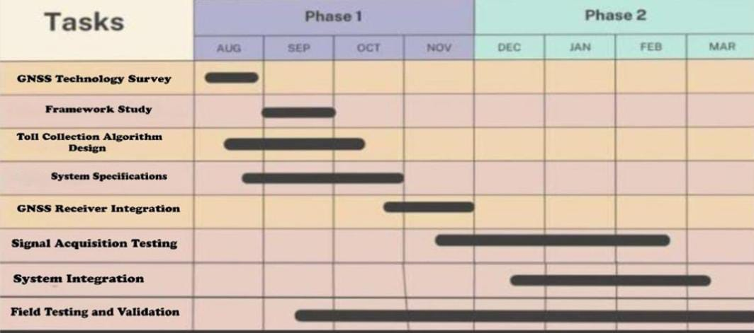
Project Plan (Clearly mention milestone for objectives under each reviews)
Gant Chart - Milestones and Activities
Resources : https://www.officetimeline.com/gantt-chart/how-to-make/excel & https://www.teamgantt.com/

Slide 4
Literature Survey (Improved post minor project)
Key Publications
GNSS-Based Tolling: The Future of Road Charging Systems (2019)In short: Proposes toll collection using GNSS to charge vehicles by distance traveled, replacing toll booths. Highlights efficiency, scalability, and addresses signal and privacy issues.
An Integrated GNSS Approach for Sustainable Toll Collection and Traffic Optimization (2024)In short: Uses GNSS for toll collection via satellite tracking, enabling dynamic pricing and transparency; addresses cost and privacy challenges.
Automatic Toll Collection using GNSS (2020)In short: Proposes a GNSS-based system for automatic toll deduction and real-time transaction updates, improving toll efficiency.
Existing Implementations – Products| Opensource| GitHub etc
https://github.com/gnss/gnss-sdr
https://github.com/taroz/GNSS-LIB
https://github.com/yimingc/gnss
https://www.gnuradio.org/
https://matlab.mathworks.com/

Slide 5
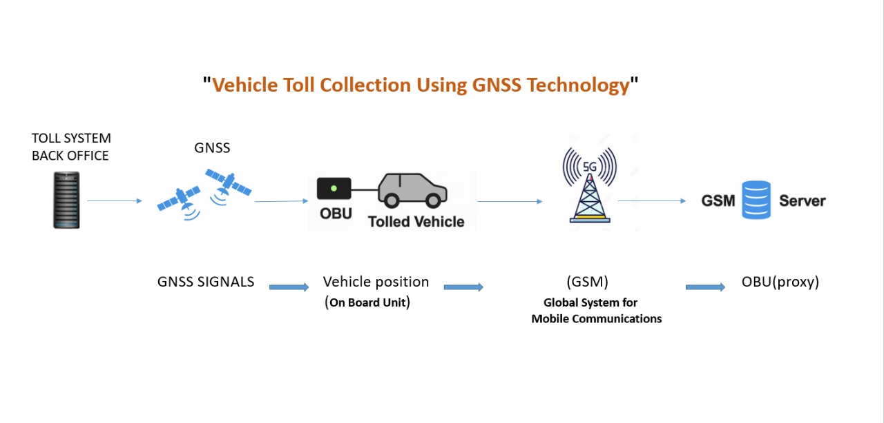
Architecture
Structural Diagram
Block Diagram/Pin Diagram
Resource - https://www.lucidchart.com/pages/examples/uml_diagram_tool

Slide 6
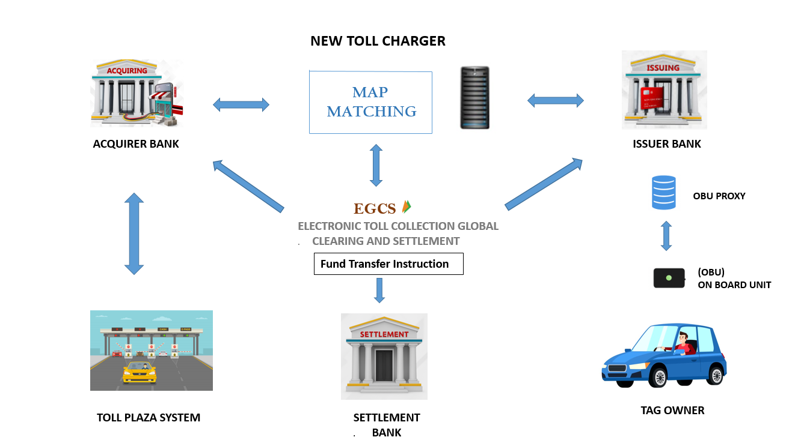
Architecture
Behaviour Diagram
Flow chart/ State machine
Resource - https://www.lucidchart.com/pages/examples/uml_diagram_tool

Slide 7
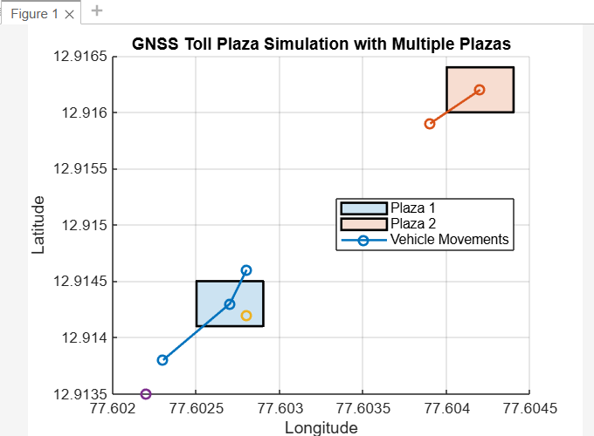
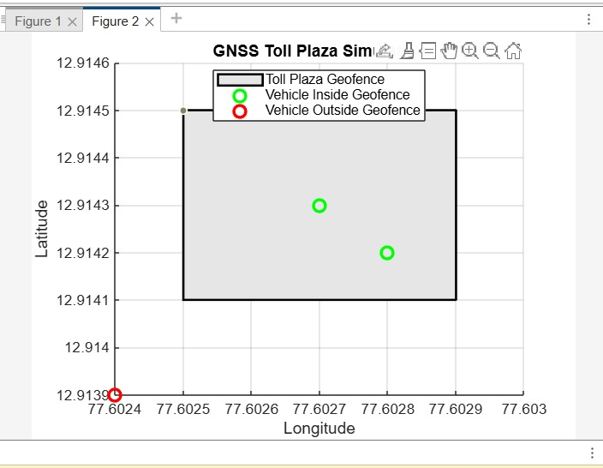
Implementation and Results – Iteration 1
Iteration 1 : Results

Slide 8
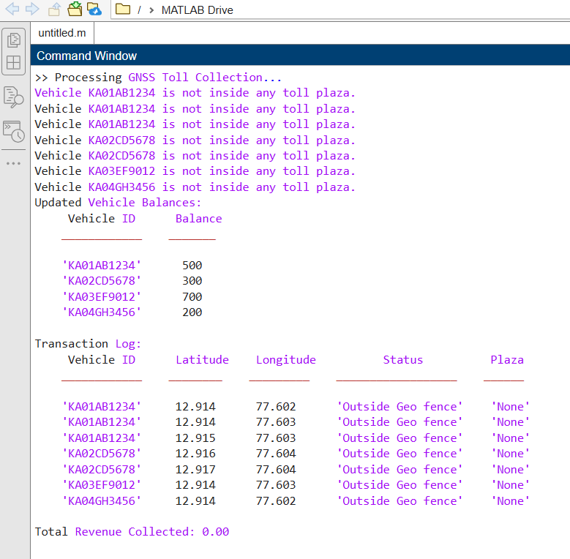
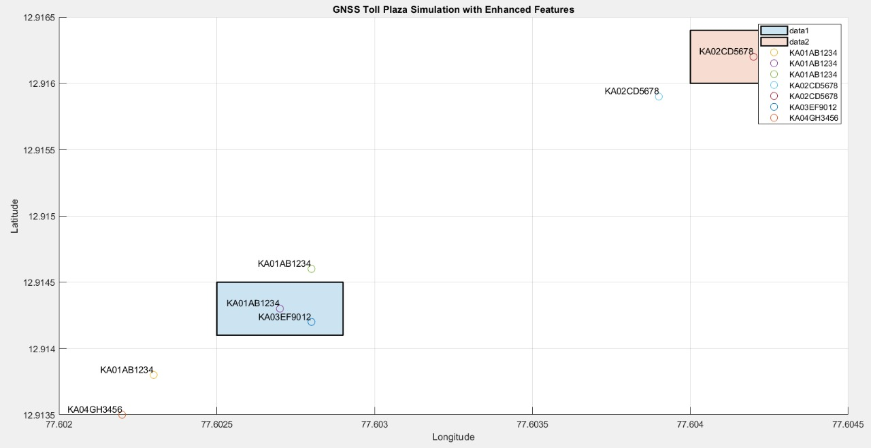
Implementation and Results – Iteration 2
Iteration : Result

Slide 9
Contribution
Team Progress and Movement
Individual Contribution
Key contributions: KHATEEB GOUISYA
Key contributions : MAVILLA AKASH
Key contributions: SANA SOWMYA
Developed and implemented MATLAB-based toll calculation algorithms.
Handled documentation, report writing, and project coordination..
Project Planning & Research: Conducted an in-depth literature survey on GNSS-based toll collection, analyzing existing solutions and identifying key challenges.
System Development & Implementation: Designed and implemented the MATLAB-based toll collection system, integrating GNSS data processing and toll calculation algorithms.
Testing & Refinement: Performed multiple testing phases, troubleshooting errors, optimizing accuracy, and refining the system for improved efficiency.
Worked on GNSS data processing and system architecture design.
Assisted in optimizing the tolling process and system efficiency.
Conducted data analysis and system testing to ensure accuracy
Conducted a literature survey and ensured smooth workflow management.

Slide 10
Conclusion & Future Work
Summary and Conclusion:
Designed a system with GNSS technology and MATLAB to track vehicles in real-time and automatically calculate toll charges based on the distance traveled, eliminating manual toll collection.
Integrated On-Board Units (OBUs) with toll infrastructure enable seamless contactless transactions and simplify toll payments.
3. The system improves toll collection accuracy, reduces manual errors, and ensures a smooth tolling process, making . . transportation more efficient and hassle-free.
Future Work :
1.Implement the GNSS-based toll collection system directly on a hardware device for real-world deployment.
2.Optimize the system for better accuracy, faster processing, and seamless integration with toll infrastructure.
3.Enhance security and privacy features while ensuring scalability for large-scale implementation.

Slide 11
THANK YOU
Have a Great Day !

